Slide 1


Department of Computer Science and Engineering
Integrating Hybrid Deep Learning Architectures for
Accurate Brain Tumor Classification
Supervisor
Dr. Bhuvaneswari R
Assistant Professor
Batch ID - B21A2425C09
Madhan B - 210701138
Mohamed Basman M - 210701160

Slide 2
Problem Statement and Motivation
Early detection and accurate classification of brain tumors remain significant challenges in medical imaging. Subtle initial symptoms and the limitations of traditional diagnostic methods often delay diagnoses, adversely affecting treatment outcomes. The manual analysis of MRI images is not only time-intensive but also subject to variability based on the expertise of radiologists, increasing the risk of misdiagnosis. To overcome these challenges, a hybrid model combining advanced image processing and deep learning techniques is proposed. This system is motivated by the critical need to enhance diagnostic accuracy, reduce analysis time, and provide healthcare professionals with reliable tools to improve early diagnosis and treatment outcomes.

Slide 3
Objectives
The primary objective of this research is to develop a hybrid model system for the detection and classification of brain tumors using MRI images. This system integrates advanced image processing with deep learning techniques to ensure high diagnostic accuracy and reliability. By leveraging the strengths of models like VGG16 and Inception V3, the system aims to achieve timely and precise tumor classification. Additionally, a user-friendly interface will be implemented to enable seamless interaction for healthcare professionals, facilitating faster and more informed decision-making. Ultimately, the project aspires to enhance early diagnosis and contribute to improved treatment outcomes for patients with brain tumors.

Slide 4
Abstract
Brain tumors are among the most critical health challenges, requiring timely and accurate diagnosis for effective treatment. This project aims to develop a robust machine learning model for detecting brain tumors in MRI images, leveraging a hybrid architecture combining VGG16 and InceptionV3 for optimal classification accuracy. The system classifies MRI scans into "tumor" and "no tumor" categories. The hybrid model integrates the strengths of VGG16's feature extraction and InceptionV3's deep learning capabilities to enhance predictive accuracy and computational efficiency. The user interface is designed using Flask, offering an accessible and user-friendly platform for medical practitioners to upload MRI scans and receive real-time diagnostic results. This project demonstrates the potential of AI-powered solutions in advancing medical diagnostics and underscores the importance of hybrid architectures in achieving higher precision in complex classification tasks.

Slide 5
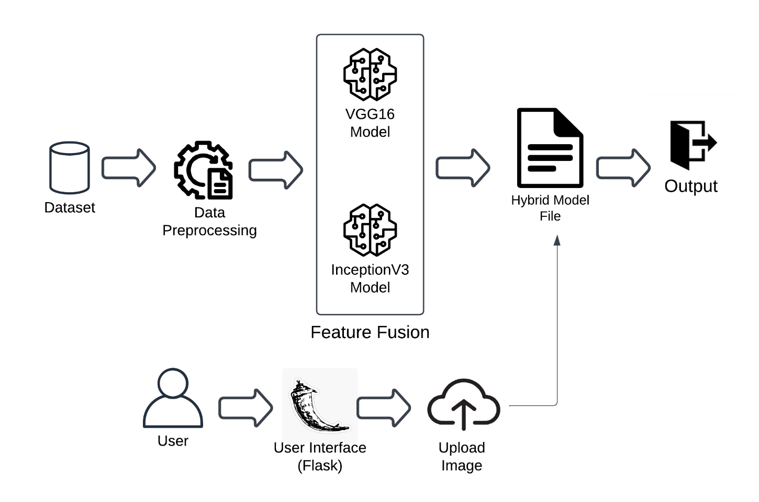
System Architecture

Slide 6
List of Modules
Data Preparation and Data Preprocessing
Fusion and Feature Extraction
Model Training and Evaluation
User Interface Module

Slide 7
Explanation of Modules
The Data Preparation and Data Preprocessing module is the foundation of the project.To ensure consistency across the dataset, images are resized, normalized, and enhanced using data augmentation techniques such as rotation, flipping, and brightness adjustments. These steps are critical to improving the quality and diversity of the data, which directly impacts the performance of the machine learning model.

Slide 8
Explanation of Modules
2. The Fusion and Feature Extraction module leverages the hybrid architecture of VGG16 and InceptionV3 to extract robust features from the MRI images. VGG16 excels at capturing detailed hierarchical patterns, while InceptionV3 contributes to the extraction of diverse features by processing multiple convolutional filters in parallel. The fusion of these models ensures that both fine-grained and global image features are effectively represented, enhancing the model’s ability to accurately classify the MRI scans.

Slide 9
Explanation of Modules
3. In the Model Training and Evaluation module, the hybrid model is trained using the preprocessed dataset. During training, the model learns to distinguish between "tumor" and "no tumor" categories based on the extracted features. Evaluation metrics such as accuracy, precision, recall, and F1-score are used to assess the model’s performance. Techniques like cross-validation and hyperparameter tuning are applied to improve the model's generalization and prevent overfitting, ensuring reliable predictions on new data.

Slide 10
Explanation of Modules
4. Finally, the User Interface Module provides a user-friendly platform for medical professionals to interact with the system. Designed using Flask, this module allows users to upload MRI scans and receive real-time classification results. The interface is intuitive and ensures that non-technical users can easily access the diagnostic capabilities of the model, making it a practical tool for assisting in medical decision-making. This module bridges the gap between advanced AI technology and its application in healthcare.

Slide 11
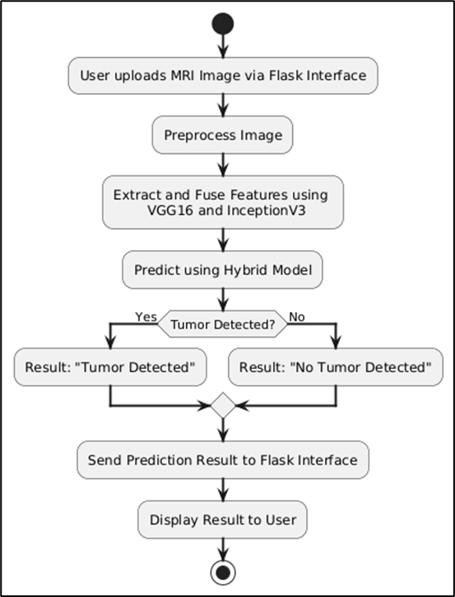
Activity Diagram

Slide 12
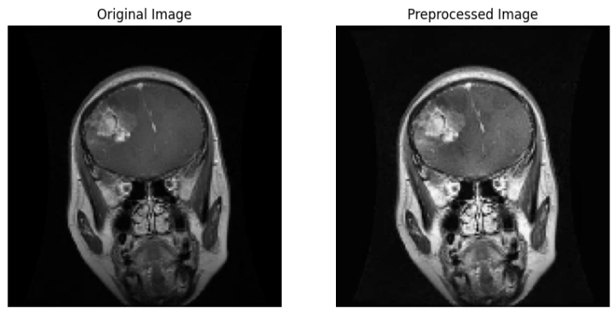
Implementation & Results
Data Collection and Data Preprocessing Result:

Slide 13
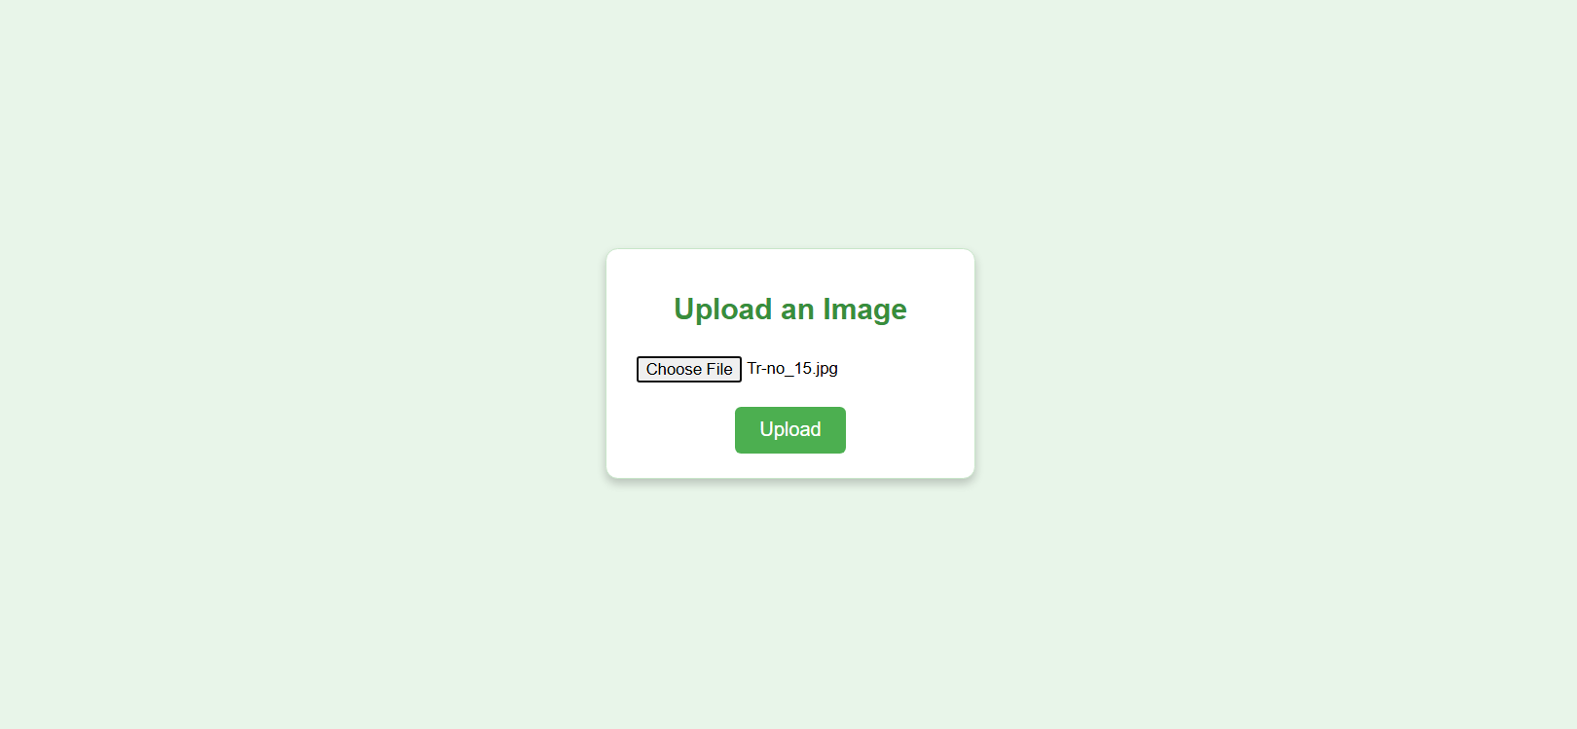
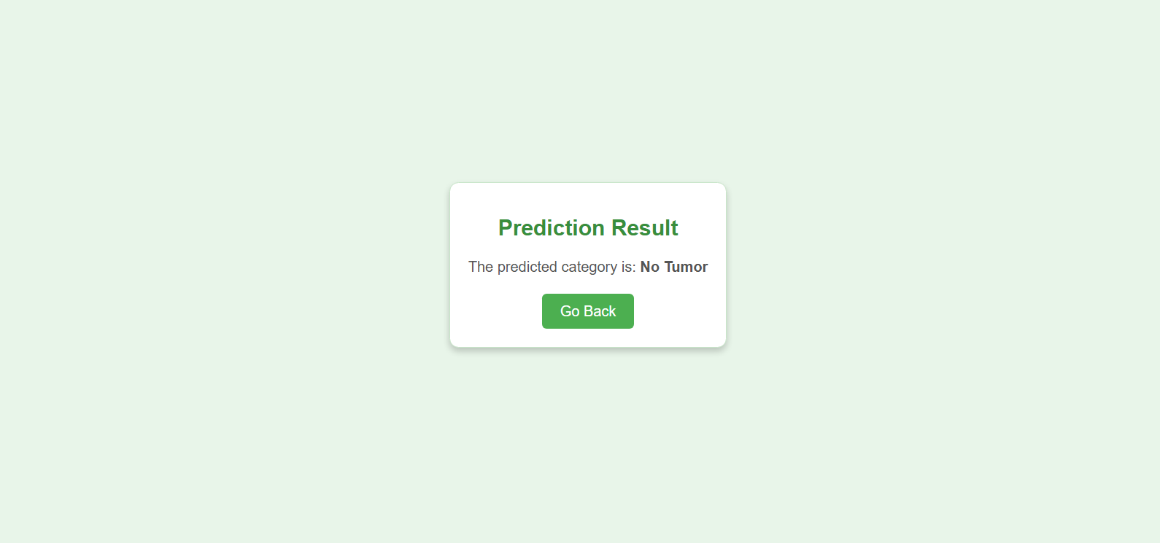
Implementation & Results
User Interface Result:

Slide 14
Conclusion & Work for Phase II
In this project we present a hybrid deep learning model, using VGG16 and InceptionV3 to classify brain MRI pictures into tumor or no tumor classes. The model combines the strengths of both architectures, and shows improved accuracy and robustness over standalone systems. The limitations of data scarcity and the lack of reliable model are overcome using preprocessing techniques and data augmentation. Evaluation metrics show that the system is successful in detecting brain tumors, and provides a useful tool for radiologists to help them make timely and correct diagnoses.
The current hybrid model performs well in separating tumor and non tumor categories, but there is room for improvement in the diagnostic capability of this model. The future work could expand its range of classification to classify specific tumor types, for example, glioma, meningioma, or pituitary tumors, and improve its ability to distinguish subtle differences. A user friendly interface supports the integration of the model into clinical workflows, allowing radiologists to upload MRI scans, view results and classify images. By prioritizing both usability and accuracy, healthcare professionals will be empowered to quicker, better decisions.

Slide 15
References
Z. Huang et al., "Convolutional Neural Network Based on Complex Networks for Brain Tumor Image Classification With a Modified Activation Function," in IEEE Access
R. Agarwal, S. D. Pande, S. N. Mohanty and S. K. Panda, "A Novel Hybrid System of Detecting Brain Tumors in MRI," in IEEE Access.
M. S. Majib, M. M. Rahman, T. M. S. Sazzad, N. I. Khan and S. K. Dey, "VGG-SCNet: A VGG Net-Based Deep Learning Framework for Brain Tumor Detection on MRI Pictures," in IEEE Access.
A. A. Asiri, T. A. Soomro, A. A. Shah, G. Pogrebna, M. Irfan and S. Alqahtani, "Optimized Brain Tumor Detection: A Dual-Module Approach for MRI Image Enhancement and Tumor Classification," in IEEE Access
M. F. Almufareh, M. Imran, A. Khan, M. Humayun and M. Asim, "Automated Brain Tumor Segmentation and Classification in MRI Using YOLO-Based Deep Learning," in IEEE Access,

Slide 16
Paper Publication Status
Preparing the paper for the conference submission, awaiting acceptance.

Slide 17
Thank You

